Slide 1
Data: Data Engineering Pipelines
Pravin Y Pawar
Extracted from
Three Levels of ML Software

Slide 2
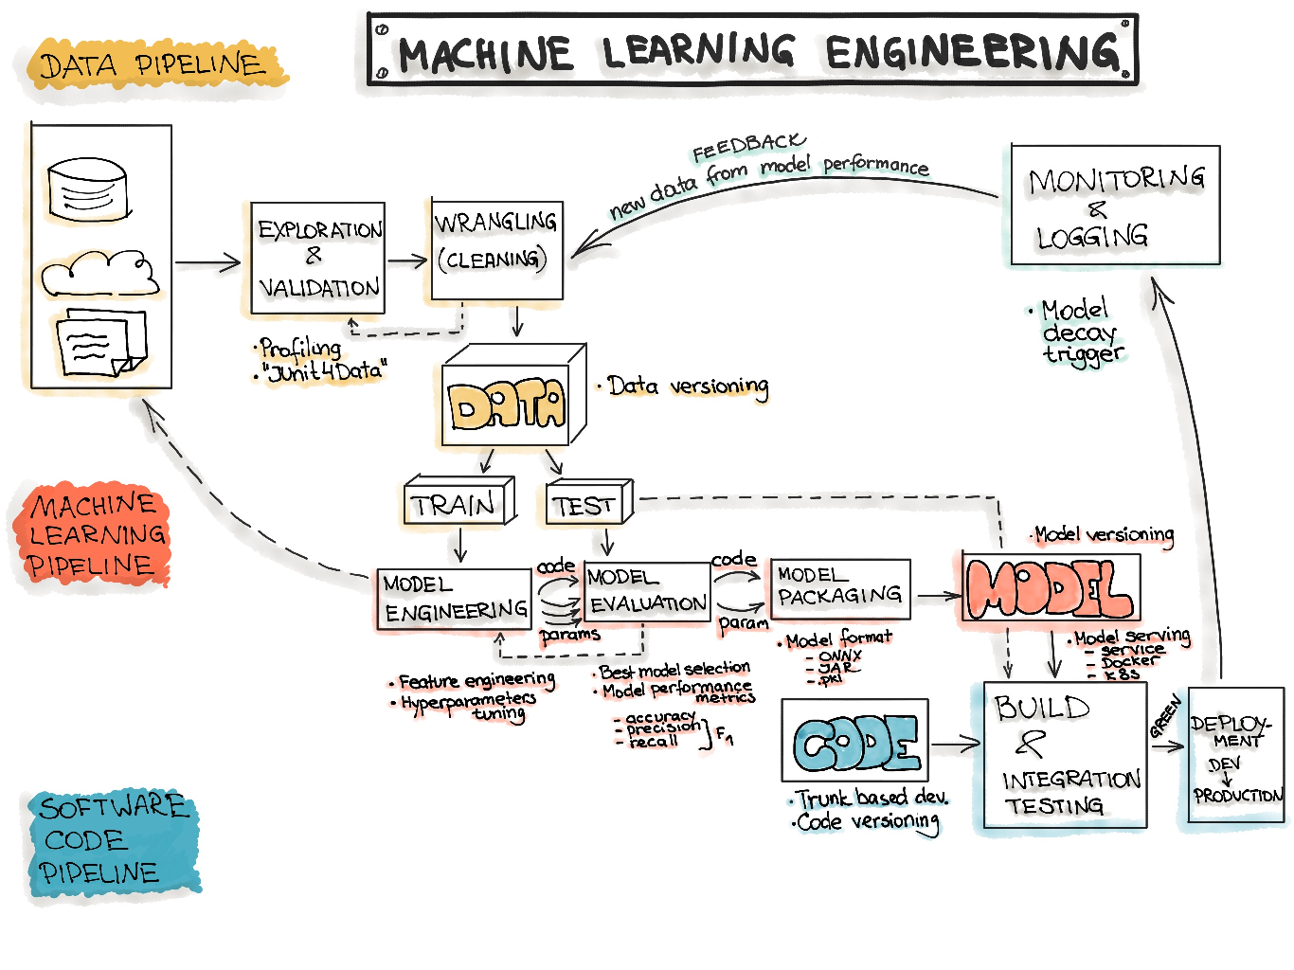
Machine Learning Workflow

Slide 3
Data: Data Engineering Pipelines
Fundamental part of any machine learning workflow is Data
Collecting good data sets has a huge impact on the quality and performance of the ML model
“Garbage In, Garbage Out”,
In the ML context means that the ML model is only as good as data using which its built
Data indirectly influence the overall performance of the production system
The amount and quality of the data set are usually problem-specific and can be empirically discovered
Data engineering is reported as heavily time-consuming
might spend the majority of time on a machine learning project constructing data sets, cleaning, and transforming data
includes a sequence of operations on the available data
final goal of these operations is to create training and testing datasets for the ML algorithms
Stages of the data engineering pipeline
Data Ingestion
Exploration and Validation
Data Wrangling (Cleaning)
Data Splitting

Slide 4
Data Ingestion
Collecting data by using various systems, frameworks and formats
such as internal/external databases, data marts, OLAP cubes, data warehouses, OLTP systems, Spark, HDFS etc
might also include synthetic data generation or data enrichment
Contains actions that should be maximally automated:
Data Sources Identification: Find the data and document its origin (data provenance)
Space Estimation: Check how much storage space it will take
Space Location: Create a workspace with enough storage space
Obtaining Data: Get the data and convert them to a format that can be easily manipulated without changing the data itself
Back up Data: Always work on a copy of the data and keep the original dataset untouched
Privacy Compliance: Ensure sensitive information is deleted or protected (e.g., anonymized) to ensure GDPR compliance
Metadata Catalog: Start documenting the metadata of the dataset by recording the basic information about the size, format, aliases, last modified time, and access control lists
Test Data: Sample a test set, put it aside, and never look at it to avoid the “data snooping” bias

Slide 5
Exploration and Validation
Exploration includes data profiling to obtain information about the content and structure of the data
The output of this step is a set of metadata, such as max, min, avg of values
Data validation operations are user-defined error detection functions, which scan the dataset to spot some errors
process of assessing the quality of the data by running dataset validation routines (error detection methods)
Includes actions:
Use RAD tools: Using Jupyter notebooks is a good way to keep records of data exploration and experimentation
Attribute Profiling: Obtain and document the metadata about each attribute, such as
Name
Number of Records
Data Type (categorical, numerical, int/float, text, structured, etc.)
Numerical Measures (min, max, avg, median, etc. for numerical data)
Amount of missing values (or “missing value ratio” = Number of absent values/ Number of records)
Type of distribution (Gaussian, uniform, logarithmic, etc.)
Label Attribute Identification: For supervised learning tasks, identify the target attribute(s).
Data Visualization: Build a visual representation for value distribution
Attributes Correlation: Compute and analyze the correlations between attributes
Additional Data: Identify data that would be useful for building the model (go back to “Data Ingestion”)

Slide 6
Data Wrangling (Cleaning)
Is a Data preparation step where we programmatically wrangle data,
e.g., by re-formatting or re-structuring particular attributes that might change the form of the data’s schema
recommended to write scripts or functions for all data transformations in the data pipeline to reuse all these functionalities on future data
Includes:
Transformations: Identify the promising transformations you may want to apply
Outliers: Fix or remove outliers (optional)
Missing Values: Fill in missing values (e.g., with zero, mean, median) or drop their rows or columns
Not relevant Data: Drop the attributes that provide no useful information for the task (relevant for feature engineering)
Restructure Data: Might include the following operations (from the book “Principles of Data Wrangling”)
Reordering record fields by moving columns
Creating new record fields through extracting values
Combining multiple record fields into a single record field
Filtering datasets by removing sets of records
Shifting the granularity of the dataset and the fields associated with records through aggregations and pivots

Slide 7
Data Splitting
Splitting the data into
Training
Validation
Test
datasets to be used during the core machine learning stages to produce the ML model

Slide 8
Thank You!
In our next session:

